Slide 1
INVENTRA INTELLIGENT INVENTORY MANAGEMENT SYSTEM
Presented by:
TEAM 4
Polepalli Keerthi
Prashant Kumar Pathak
Nagamani Mannempali
Vaishnavi vankalas
Jerusha

Slide 2
INTRODUCTION
Inventory management is essential for tracking and controlling stock efficiently
Traditional systems often face issues like manual errors and poor visibility
Inventra is designed to automate and simplify inventory handling
It helps organizations manage products, stock levels, and reports effectively

Slide 3
PROJECT OBJECTIVE
To develop a secure and efficient inventory management system
To implement user authentication using JWT
To manage products and stock using a database-driven approach
To monitor inventory levels and avoid stock shortages
To provide a user-friendly dashboard for inventory tracking

Slide 4
PROJECT DESCRIPTION
Inventra is an intelligent inventory management system
Designed to reduce manual work and errors
Maintains product and stock records digitally
Provides real-time inventory tracking
Improves accuracy and efficiency

Slide 5
MODULES OVERVIEW
Authentication Module
Product Management Module
Inventory Management Module
Low Stock Alert Module
Reports Module

Slide 6
TECHNOLOGY STACK
JWT
Frontend
HTML, CSS, JavaScript
Backend
Spring Boot
Database
MySQL
Authentication
JWT
Tools
Postman, VS Code

Slide 7
SYSTEM ARCHITECTURE
User interacts with frontend
Requests sent to backend APIs
Authentication handled using JWT
Data stored in MySQL database
Response sent back to UI

Slide 8
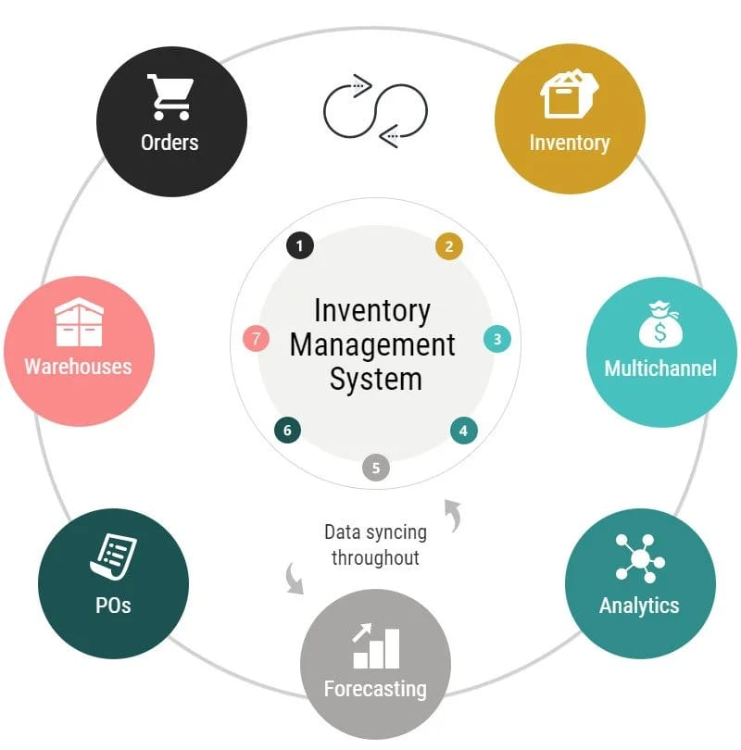
INVENTORY WORKFLOW
Orders are processed
Inventory updated in real time
Warehouse data synchronized
Analytics generated
Continuous data syncing

Slide 9
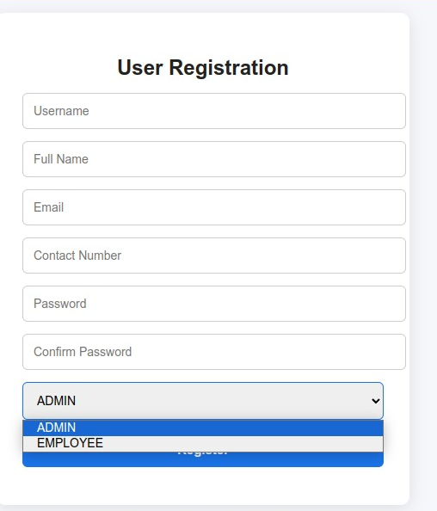
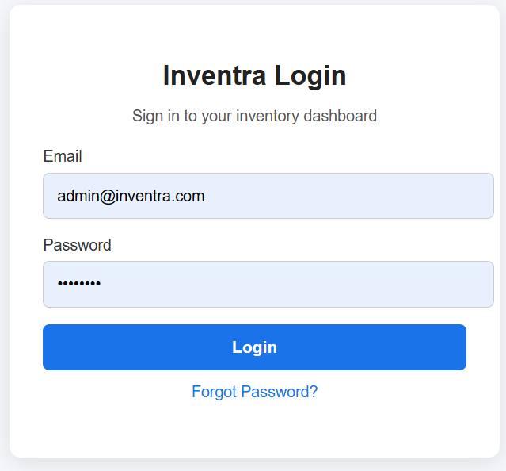
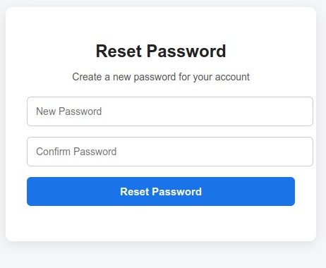
1. AUTHENTICATION MODULE
User registration
Secure login
JWT-based authentication
Password reset option
Role-based access

Slide 10
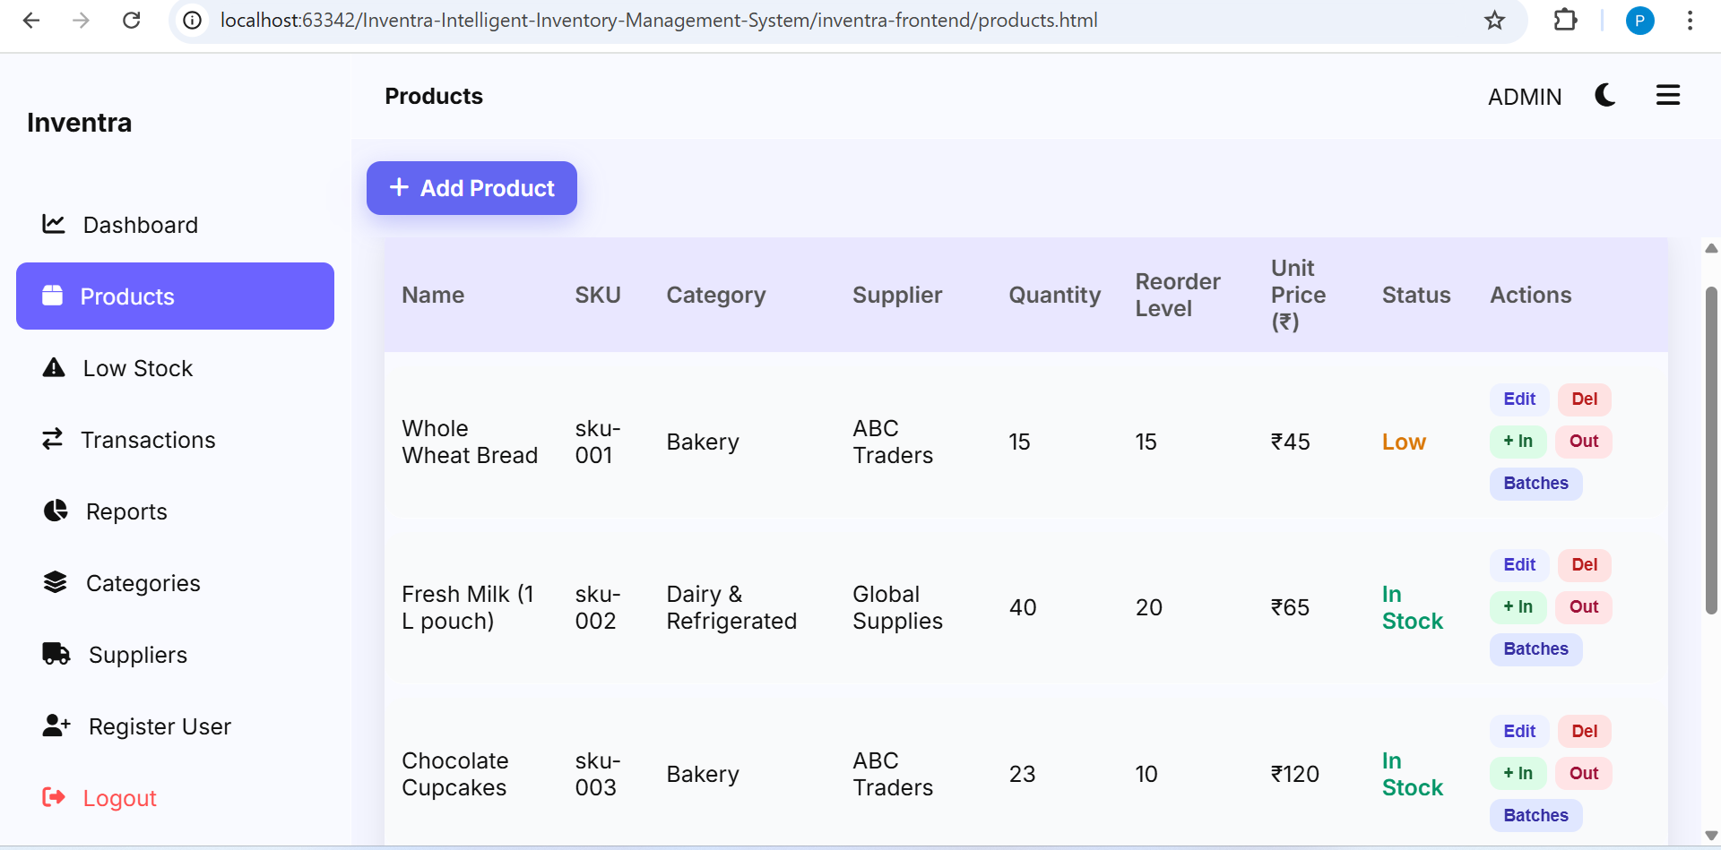
2.PRODUCT MANAGEMENT MODULE
Add new products
Edit product details
Delete products
View product list
Stock In / Stock Out

Slide 11
3.INVENTORY MANAGEMENT MODULE
Tracks stock quantity
Updates inventory automatically
Maintains stock records
Prevents stock mismatch

Slide 12
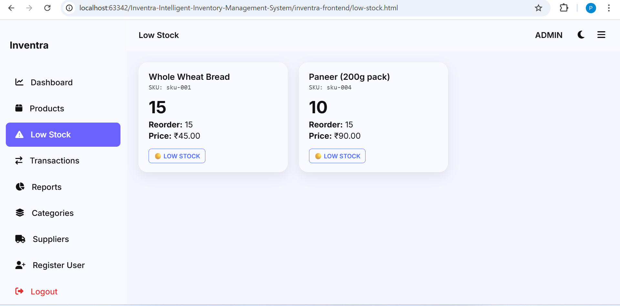
4.LOW STOCK ALERT MODULE
Detects low stock items
Displays alert messages
Shows reorder level
Prevents stock-out

Slide 13
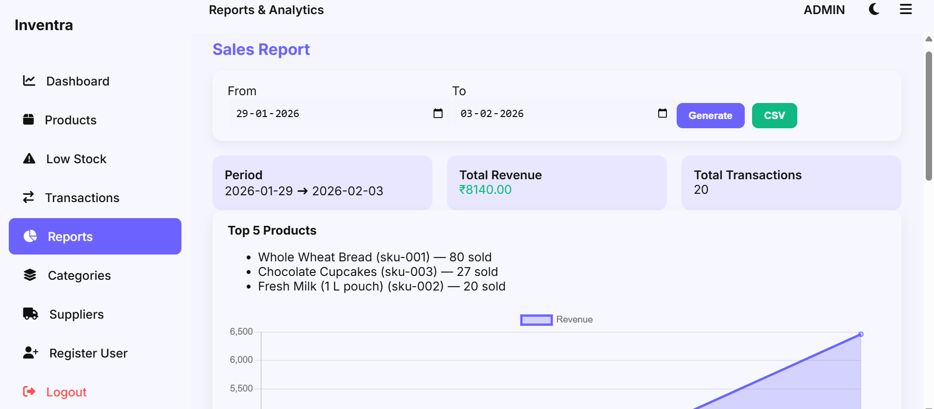
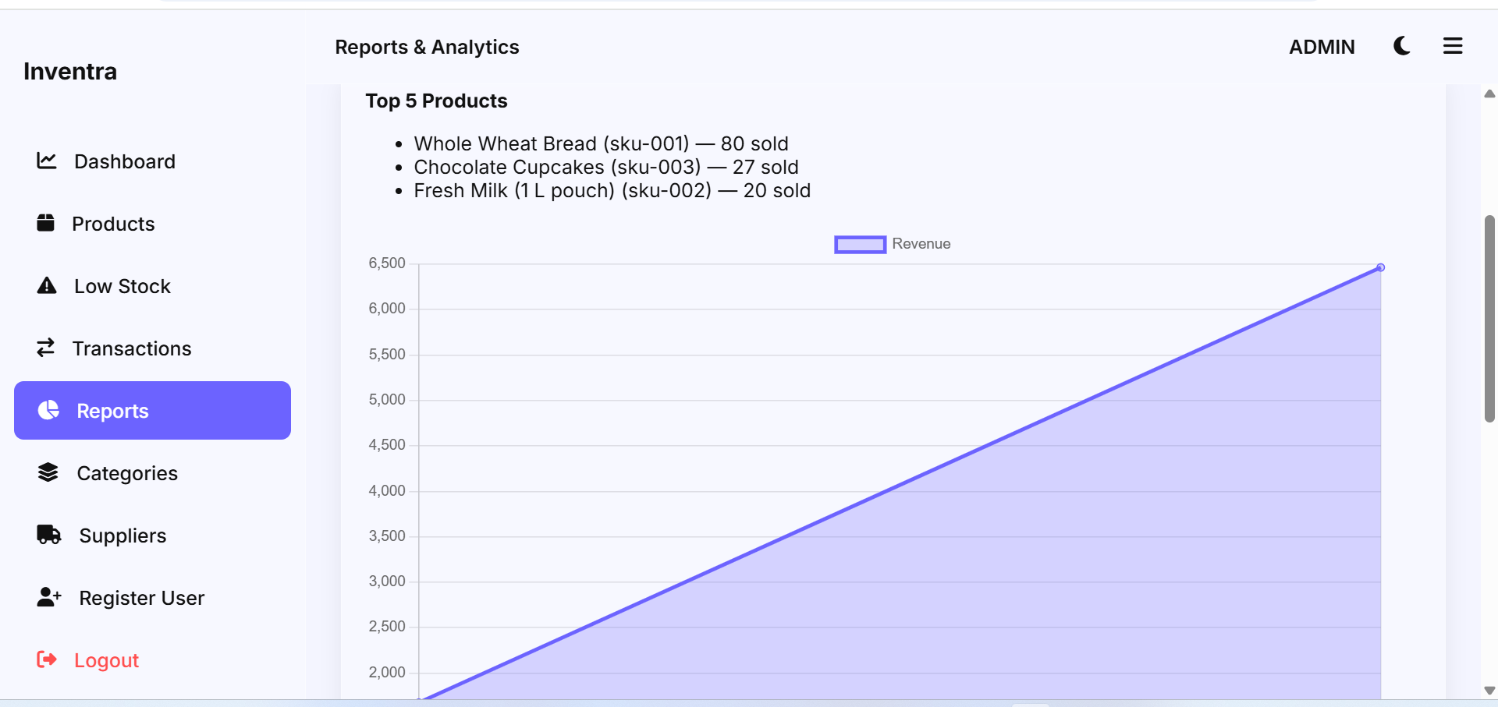
5.REPORT MODULE
Displays inventory summary
Shows stock and sales data
Generates reports
Helps in decision-making

Slide 14
CHALLENGES FACED
Implementing secure authentication
Managing product and stock data
Handling backend and frontend integration
Debugging API and database errors

Slide 15
SOLUTIONS IMPLEMENTED
JWT used for secure login
Structured database design
REST APIs for communication
Proper validation and testing

Slide 16
LEARNING OUTCOMES
Full stack development
Spring Boot and MySQL
JWT authentication
API testing using Postman
Team collaboration

Slide 17
CONCLUSION
Inventra provides an efficient inventory solution
Automates stock management
Reduces errors and manual work
Improves decision-making
Useful for real-world applications

Slide 18
THANK YOU
Any Questions?

